Slide 1

SHARK ATTACKS
CLEANING DATA PROJECT – IRONHACK – JANUARY 2020
Abélia PETELLE

Slide 2
surfers
Hello
welcome

Slide 3

WORD LIFE-GUARD ASSOCIATION
AIM OF THE PROJECT → understand where we have to prevent the most population from shark attacks

Slide 4
What are the riskiest countries for surfers ?
Question raised

Slide 5
PROCESS FOLLOW
IMPORT THE DATA FRAME
INSPECT THE DATA
FIND A QUESTION TO RAISE
DEFINE A PERIMETER
CLEAN THE DATA
ANALYSE THE DATA
EXPORT THE DATAFRAME

Slide 6
CLEANING THE DATA
What do I want ?
JUST the surfers
To know if they died or not
From which countries
What do I need :
List of imperative columns (Activity, Countries, etc)
List of columns that can help me to fill other columns
Method used :
Drop
Replace
Dummies
Isnull

Slide 7
OUPUT FILE
COLUMNS
Case Number, Date, Year, Type, Area, Location, Injury, pdf : no change
Activity : fill the NaN columns
Country : clean it so that all countries were unique
Fatal (Y/N) : clean it to have only two unique values
Dead_surfers : new column added to do dummies
ROWS
Drop : all the rows that are

Slide 8
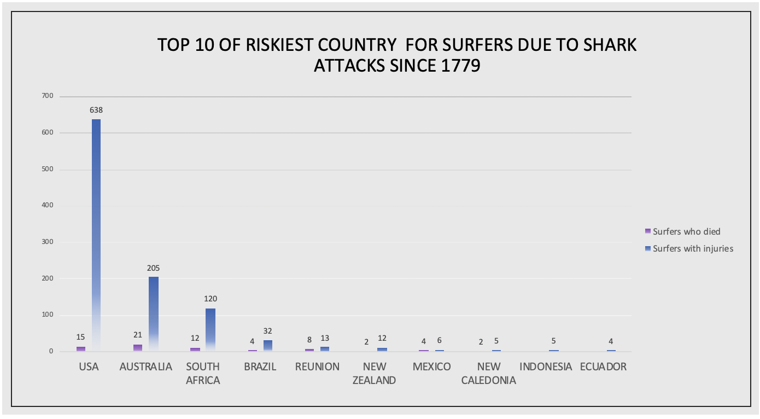

Slide 9
LIMITS
OBSTACLES ENCOUNTERED
Technical obstacles : lack of practice, long time to deblock errors, etc.
QUESTION RAISED VS FINAL RESULT
What I did wrong :
I diddn’t do a time analysis and riskiest countries may change since 1779
I keep ONLY the surfers but a swimmer who were attacked on a surfer’s spot could also be interested
In order to have more relevant result :
Focus more on the location then just the countries
Take in account the other people who where attacked on surfer’s spots
THE FINAL SCOPE : only 1 143 VS 5 992 cases
Less demonstrative data
Do another analysis keeping the other rows : Who sharks are attacking ?

Slide 10
LESSONS LEARN
TAKE TIME TO LOOK A THE DATA AND TO FIND A QUESTION TO RAISE
IT IS NOT A BIG DEAL TO WORK ALONE WITH SOOOO MANY DATA
WRITE THE RIGHT KEY WORDS ON GOOGLE TO FIND HELP

